Slide 1
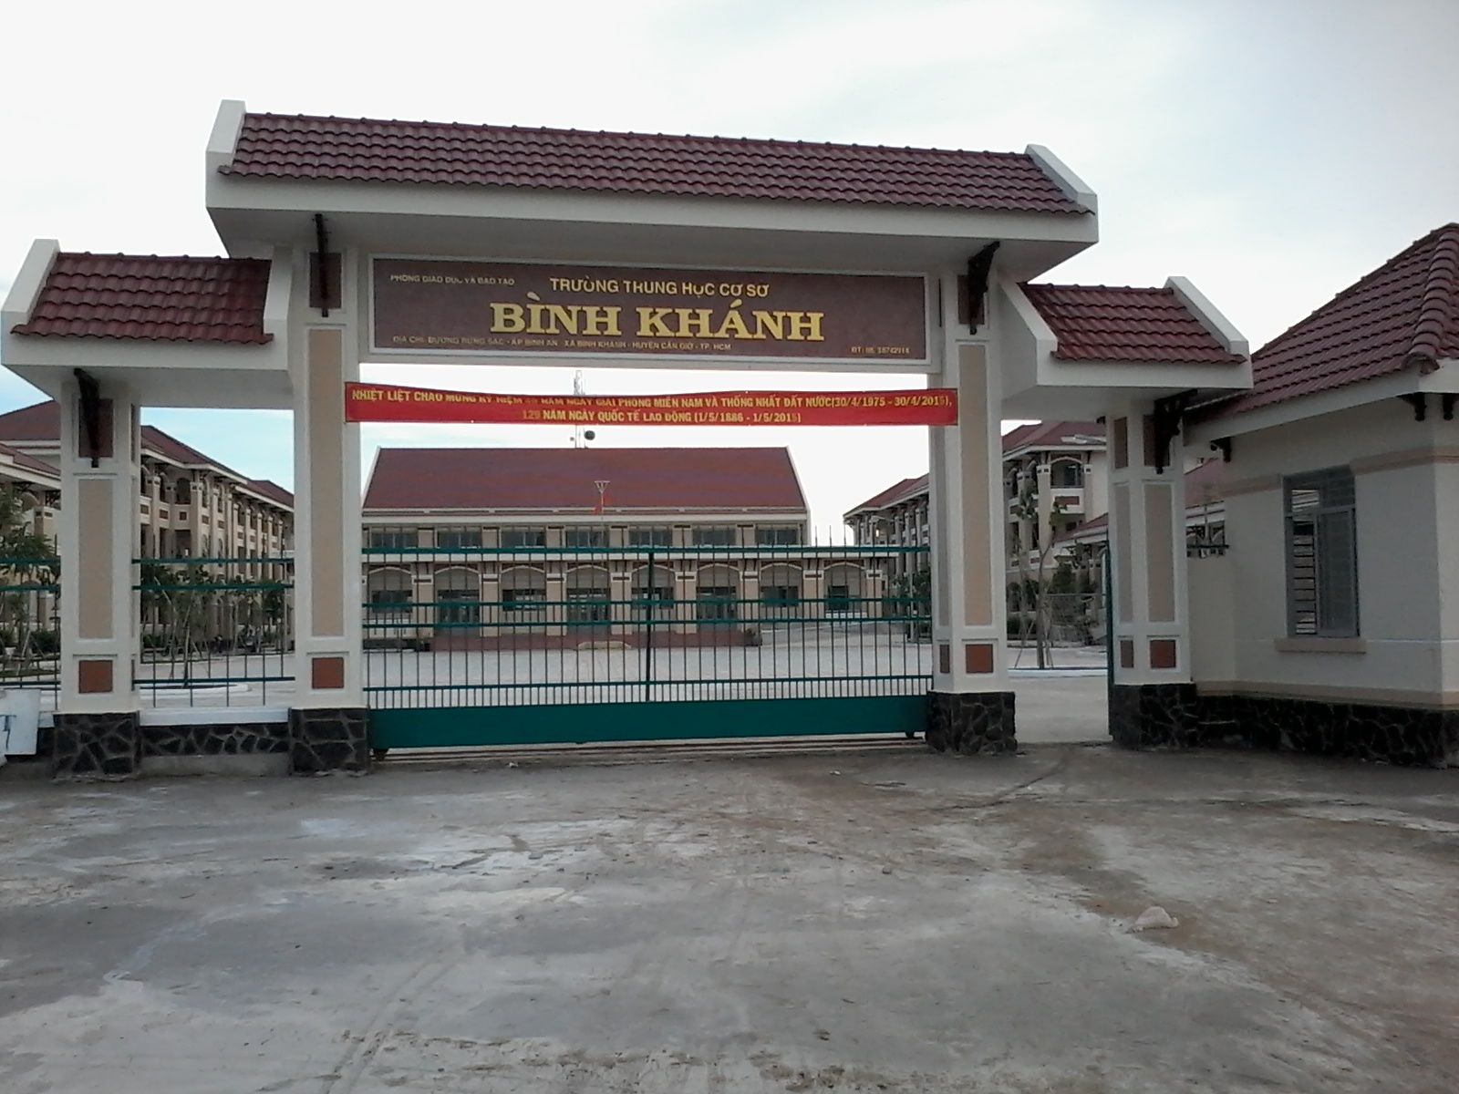



BINH KHANH SECONDARY SCHOOL
FRIENDS PLUS 6

Slide 2


Slide 3
Rules
Fill in the Bingo grid with 12 words about sports.
One volunteer to choose a word and describes it, using hints but not the word itself.
- Cross off that word if you have it on the Bingo grid. The next student describes a word and so on.
- The first person to get four words on a vertical, horizontal, or diagonal row is the winner.

Slide 4
BINGO

Slide 5
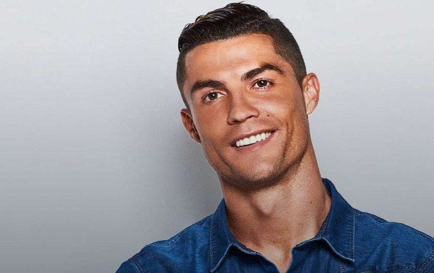
“What is he famous for?
Who is he?

Slide 6
Name five famous international sports stars. Who is the most famous sports star in your country?
What is his / her sport?

Slide 7

UNIT 6
SPORTS
Lesson 7: WRITING

Slide 8
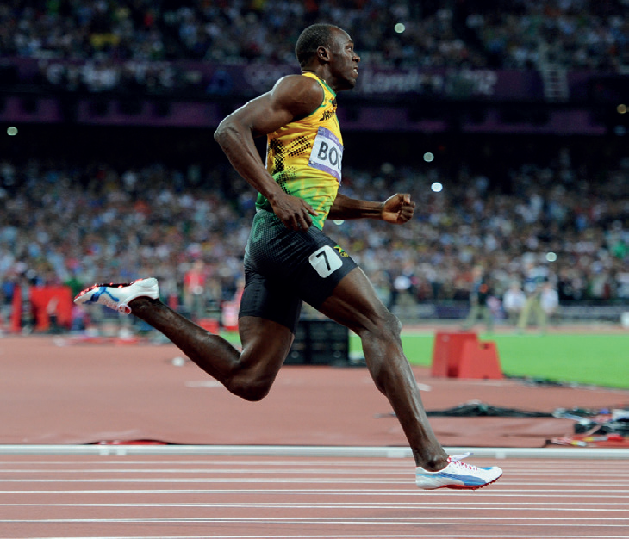
Usain Bolt

Slide 9
Read the profile
1) Where was Usain Bolt born?
➔ He was born in Sherwood Content, Jamaica.
2) When was his first world champion?
➔ His first world champion was in 2002.

Slide 10
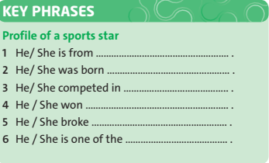
Look at the Key Phrases. Which phrases do we use in paragraphs 1–3?

Slide 11
Read the profile again and check.
Paragraph 1:
1 and 2
Paragraph 2:
3
Paragraph 3:
4, 5 and 6

Slide 12
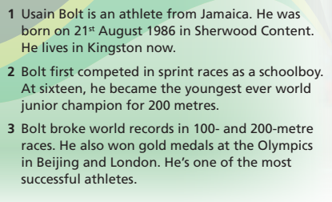
Read the text again. Match three topics from a–e with paragraphs 1–3.
b. Greatest moments
c. Basic information
e. Early career
a. His life now
d. Problems

Slide 13
OPTIONAL ACTIVITY

Slide 14
Complete the sentences from memory
He was born _______ 21st August 1986.
He __________ lives in Kingston.
He first competed ____________ a schoolboy.
He became the youngest ever world junior champion ______ the age of 16.
He ____________ world record in 100- and 200- metre races
on
now
as
at
broke

Slide 15
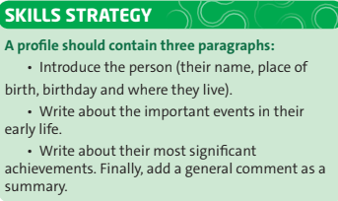
READ THE SKILL STRATEGY

Slide 16
Read the skill strategy again. Number the paragraph 1-3.

Slide 17
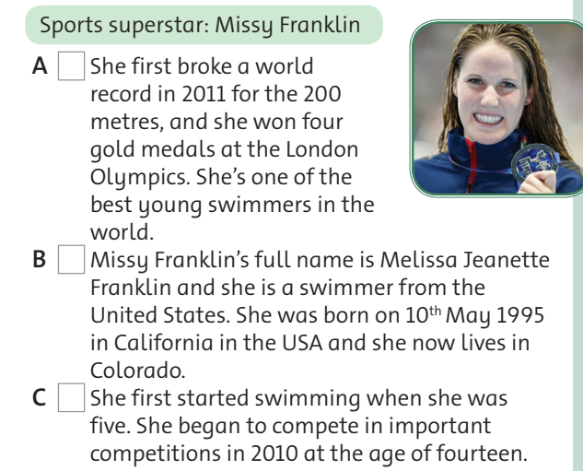
3
1
2

Slide 18
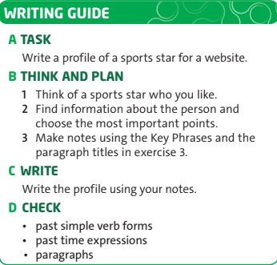
Read the skill strategy again. Then follow the steps in the writing guide.

Slide 19

Homework
Workbook: Exercises on page 47.
- Write a profile of your favorite sports star.

